Slide 1
Understanding your Authorized Funding

Slide 2
What are is my authorized funding?
Your authorized funding is the amount of money you have available for your services through the North Dakota Self-Direction Program. This funding amount is outlined in the PDF authorization created by your Program/Case/Service Manager. Information listed on the authorization includes
Your authorized services
The amount of funding you have per service
The time frame in which that funding can be used.

Slide 3
What does an hour cost?
The cost of an employee’s work can be calculated as follows: Hours X Pay Rate X Employer Tax Rate = Cost of the Hours
Example- One hour of John’s time would cost you the following: 1 hour X $15.00 X 1.1108 (11.08% tax rate) = $16.66

Slide 4
How many hours do I have?
The amount of hours you can submit and remain within your authorized funding can be found by taking your authorized funding amount and dividing it by the cost of one hour of an employee’s work. Example
You have $1000.00 of funding. Your employee John Doe is paid $15.00 an hour and your employer tax rate is 11.08%. The number of hours you can submit then would be
$1,000.00 ÷ ($15.00 X 1.1108 employer tax rate) = 60.02 hours

Slide 5
How do my hours interact with my authorized funding? (cont.)
Knowing that cost determines how many hours you can submit and remain within your authorized funding, there are several factors you will want to keep in mind:
The pay rate for the employee submitting hours
If overtime occurs
The employer tax rate for the employee submitting hours.
All of the above can impact whether the hours you are submitting remain within your authorized funding or exceed it.

Slide 6
Employees with Different Pay Rates
If your employees have the same pay rates as one another, hours can be worked interchangeably without much impact on how this will use your authorized funding (assuming there is no overtime and the employee’s have the same employer tax rate for their hours). If however your employees have different pay rates, hours being worked by one employee vs another can greatly impact the number of hours you can submit and be within authorized funding.

Slide 7
Employees with Different Pay Rates (cont.)
John provides In Home Support (IHS) at $15.00 an hour. You are anticipating that he will work 70 hours. Sarah provides IHS at $16.00 an hour. You are anticipating that she will work 60 hours. Submitting 130 hours this way will exactly use your authorized funding. If they were to submit these hours (and no overtime occurs), the cost would be
John-70 hours X $15.00 X 1.1108 = $1166.34 +
Sarah-60 hours X $16.00 X 1.1108 = $1066.37 _____________________________________________________________ $2,232.71

Slide 8
Employees with Different Pay Rates (cont.)
However, let’s say Sarah were to work 70 hours and John only worked 60. Even though the same number of hours are used, because Sarah provides IHS at a higher pay rate, submitting hours this way would cause you exceed your authorized funding amount. If they were to submit these hours, the cost would be
John-60 hours X $15.00 X 1.1108 = $999.72 +
Sarah-70 hours X $16.00 X 1.1108 = $1244.10 _____________________________________________________________ $2,243.82 ($11.11 over authorized funding amount)

Slide 9
When you go over your authorized funding amount
When you exceed your funding, you are putting yourself as the employer and your employees at risk with respect to state and federal laws, worker’s compensation and unemployment insurance, as well as Department of Labor regulations.
In addition to the above, going over your authorized funding can result in
Delays in employee payroll
Removal of payroll
Having to pay employees out-of-pocket for funds owed in excess of your funding.

Slide 10
Overtime
Under the Fair Labor Standards Act, if an employee works more than 40 hours in the work week (Sunday-Saturday), hours in excess of 40 are considered overtime. Overtime hours are paid at the rate of time and a half the employee’s normal rate of pay.
Example
Let’s say your employee John Doe works 45 hours in a work week and their normal rate of pay is $15.00 an hour. Hours 1-40 will be paid at the normal rate of $15.00 an hour. Hours 41-45 will be paid at John’s overtime rate of $22.50 an hour ($15.00 X 1.5).

Slide 11
Overtime vs No Overtime
Employee Name | Hours Worked | Pay Rate | Employer Tax Rate | Cost of Hours
Jane Doe | 35 | $15.00 | 11.08% | $583.17
John Doe | 35 | $15.00 | 11.08% | $583.17
Total Cost of Hours |  |  |  | $1,166.34
Employee Name | Hours Worked | Pay Rate | Employer Tax Rate | Cost of Hours
Jane Doe | 50 | $15.00 for the first 40 hours $22.50 for the last 10 hours | 11.08% | $666.48 (cost of the 40 regular hours) $249.93 (cost of the 10 overtime hours)
John Doe | 20 | $15.00 | 11.08% | $333.24
Total Cost of Hours |  |  |  | $1,249.65

Slide 12
Employer Tax Rate
Based on your role in the North Dakota Self-Direction Program, you are considered a household employer.
As a household employer, you are required to pay a percentage of certain taxes on your employee’s wages, otherwise referred to as your employer taxes.

Slide 13
Employer Tax Rate
Within this program, your employer taxes consist of the following which when combined will give you your employer tax rate:
6.2% Social Security
1.45% Medicare (SS + Medicare combined represent the Federal Insurance Contributions Act or FICA)
1.7% Worker’s Compensation Insurance
0.6% Federal Unemployment Tax Act (FUTA)
X.X% State Unemployment Tax Authority (SUTA) The SUTA rate varies from employer to employer and is subject to change annually based on the following factors:
The length of time an individual has been a household employer.
The amount of payroll paid each year.
The number of unemployment claims filed.

Slide 14
Employer Tax Exemptions
There are two reasons why if applicable your employee’s wages might be exempt from certain employer taxes/not have them applied:
A relationship exists between you as the employer and the employee that makes the employee’s wages exempt from certain employer taxes.
Your employee has hit a yearly wage threshold that makes it so the rest of their wages for the year do not require a certain employer tax to be applied.
If an employee’s hours are exempt from an employer tax, that tax will not be applied in the payment of their wages.
To illustrate, let’s compare the hourly cost to you of two of your employees, Jane Doe and John Doe.

Slide 15
Employer Tax Exemptions (cont.)
You have an employer tax rate of 11.08% Both Jane and John are paid $15.00 an hour. John Doe’s wages are FUTA exempt for her work for you while Jane Doe’s are not.
Here is how much an hour of John’s work will cost vs Jane’s work:
John Doe- 1 hour X $15.00 X 1.1108 (your employer tax rate)= a cost of $16.66 an hour
Jane Doe- 1 hour X $15.00 X 1.1048 (your employer tax rate minus the FUTA tax rate of .006 which is not applied due to the exemption)= a cost of $16.57 an hour

Slide 16
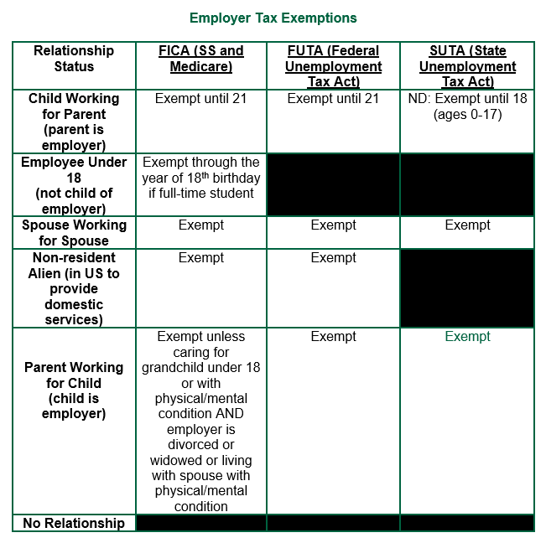
Relationship-Based Exemptions
Based on the relationship between you as the employer and your employee, there may be certain tax exemptions that apply to hours worked by that employee.
This relationship is provided to Veridian on the Statement of Relationship form in the employee packet. Veridian notes this relationship on file and if the relationship qualifies for an exemption, applies it appropriately to that employee’s hours worked.

Slide 17
Thresholds
Yearly tax thresholds exist that when reached will exempt an employee's future hours from having certain taxes applied for the remainder of that year. A threshold is considered met when in a year you have paid an employee the at least the gross wages at which the threshold is set for that year. For example, if an employee hit the FUTA threshold in May of 2023, the wages they submit for the rest of 2023 will not have FUTA taxes applied to them.
The exact amounts of these thresholds are subject to change on a yearly basis.
For 2023, the thresholds are as follows
• The FUTA threshold is $7,000.00
• The North Dakota SUTA threshold is $40,800.00

Slide 18
If there is an exemption, keep in mind
All other applicable employer taxes would continue to be applied as normal.
All employee taxes are applied as normal.
Due to the uncertain nature of when/if a thresholds will be reached in the year, you will want to reference your account statements. This will allow you to see when/if an employee of yours has hit a yearly threshold and will no longer have certain taxes applied to future hours they work in the year.

Slide 19
How can I stay within my authorized funding?
Keeping the following in mind can help prevent you from going over budget:
Know your authorized funding amount- Knowing how many dollars are available to you is key in not exceeding your funding. Keep a copy of your current and previous authorization PDF’s to ensure you have this information at your disposal.
Review hours before submitting- Carefully review the hours for your employees before submitting to ensure accuracy. Errors in submission can cause inaccurate payments and by extension exceed your funding.

Slide 20
How can I stay within my authorized funding? (cont.)
Track hours paid- After each payroll, it is recommended you generate and review your Participant Statement to see what hours were paid and how much money is left in your authorization. This will allow you to know what can be submitted for the next payroll without exceeding your funding.
Use the employer payroll calculator- To help schedule your employees in a way that keeps you within your authorized funding, there is the Employer Payroll Calculator.
This allows you to determine how much your employee’s hours will cost simply by adding the number of hours the employee will work along with their pay rate into the calculator. The calculator then multiplies these amounts by your employer tax rate and provides you the cost of the hours. The calculator also allows you to take into account overtime and various employer tax exemptions to further understand what an employee’s hours will cost.

Slide 21
Questions?
If you have questions about the content of this presentation or items that weren’t covered that you would like addressed, please let us know!

